Slide 1
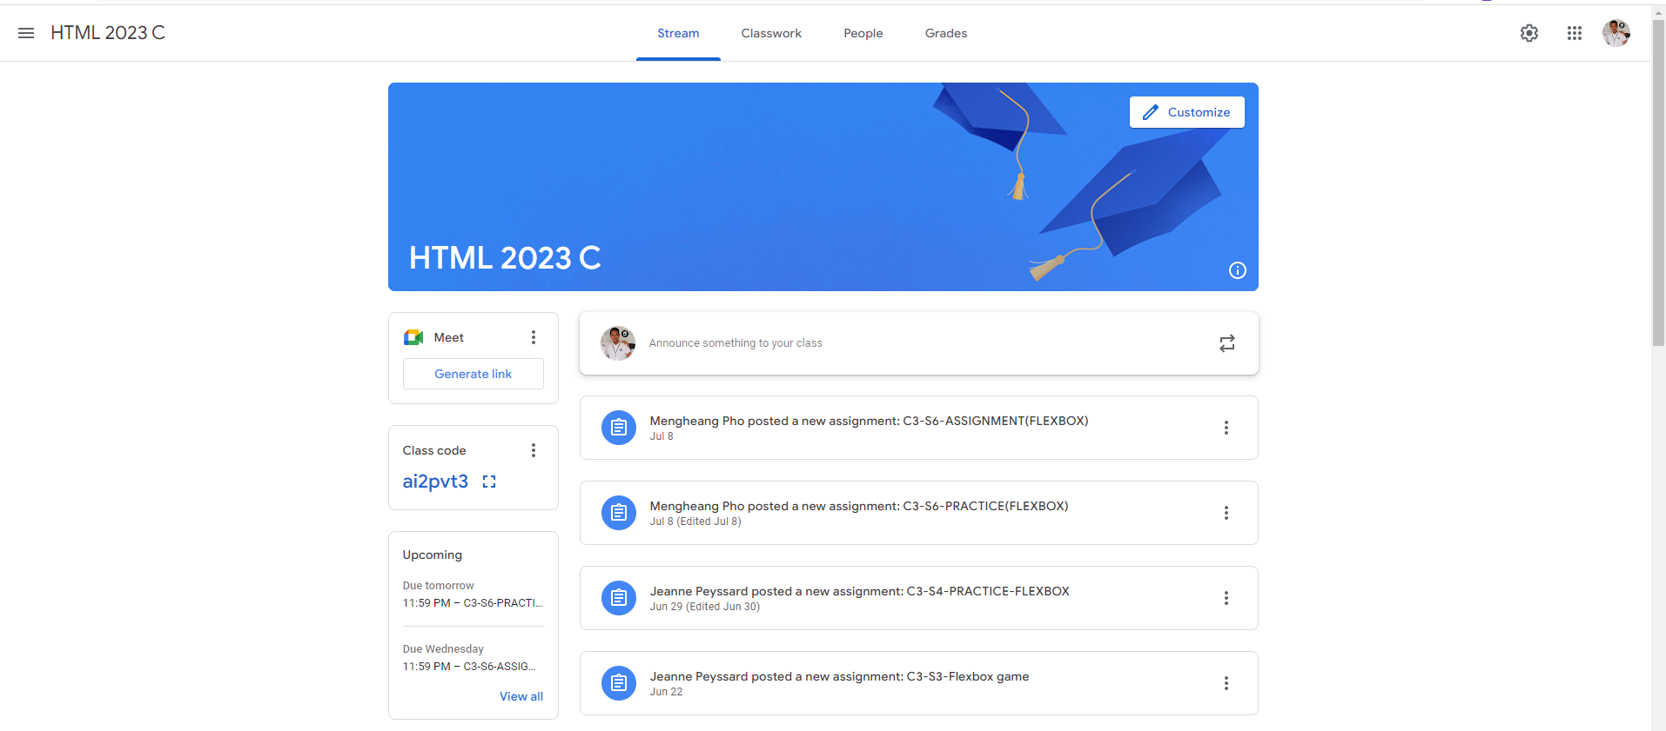
Identify root components of website below

Slide 2
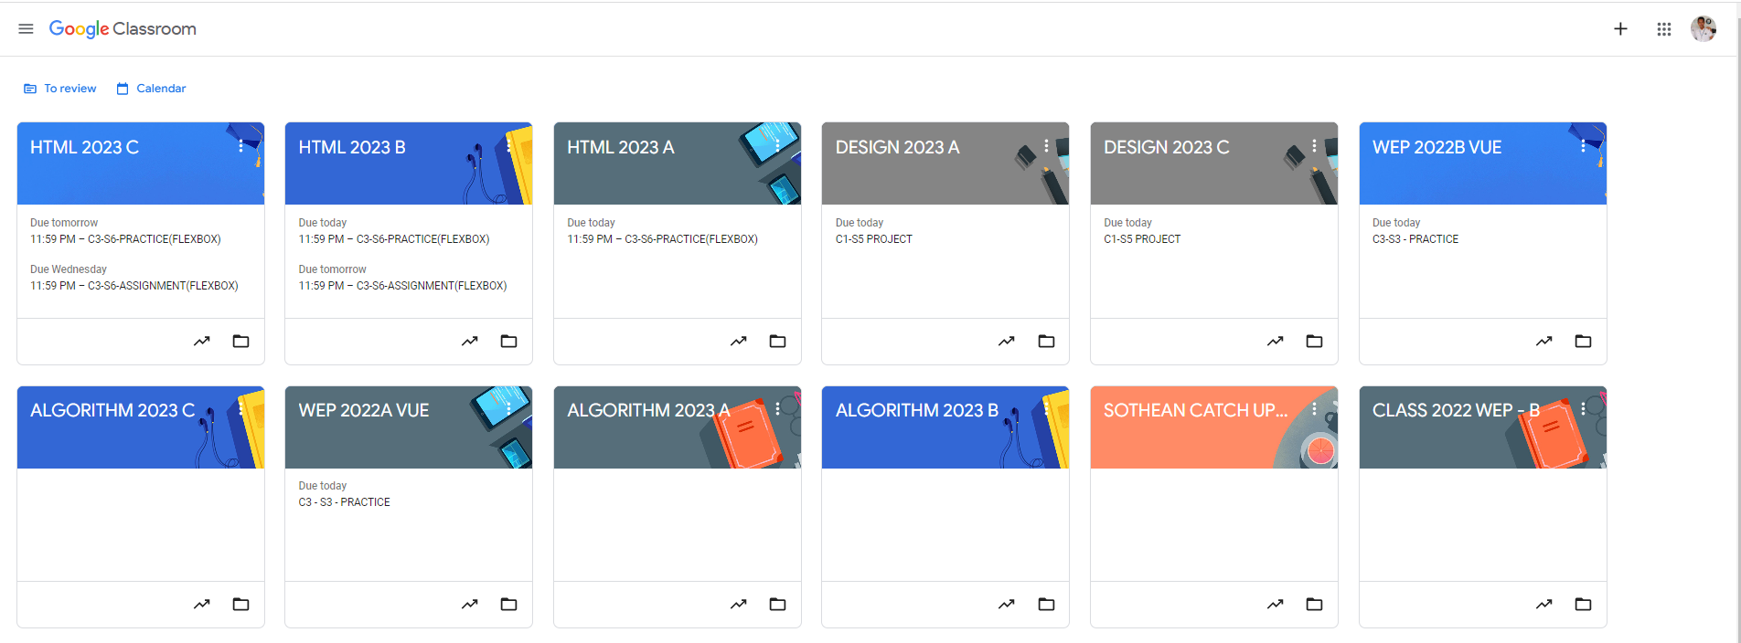
Root div
- Height: 100vh
content
nav
Flex: 0
header
Flex: 0
Flex: 1

Slide 3
Div:header
Div: Container
First, we have to divide the page into two divs. These two will become the parents of smaller divs and provide the layout to another div.

Slide 4
Div: option
Div: link
Div:info
In div:header. We need to divide it into 3 small divs in order to arrange them.

Slide 5
padding
padding
div: classrom
padding
padding
div: classwork
div: link
div: assignments
In this div, the content is centered, and padding is used to create space around the design. We split the div into two parts: "classroom" and "classwork." The "classwork" part was then divided into two sections: "meetings" and "assignments" to make it easier for the user.

